Slide 1
How to estimate the Direct-to-Total Labor Ratio using U.S. Bureau of Labor Statistics
Download industry wage data from the U.S. Bureau of Labor Statistics
Step 2
Select which occupations are Direct Labor
Step 3
Calculate the Direct to Total Labor ratio for the industry
Step 1

Slide 2
Download industry wage data from the U.S. Bureau of Labor Statistics
Step 1
1. Go to:
And click on OES ‘Databases’
2. Click on ‘One-screen data search’
https://www.bls.gov/oes/

Slide 3
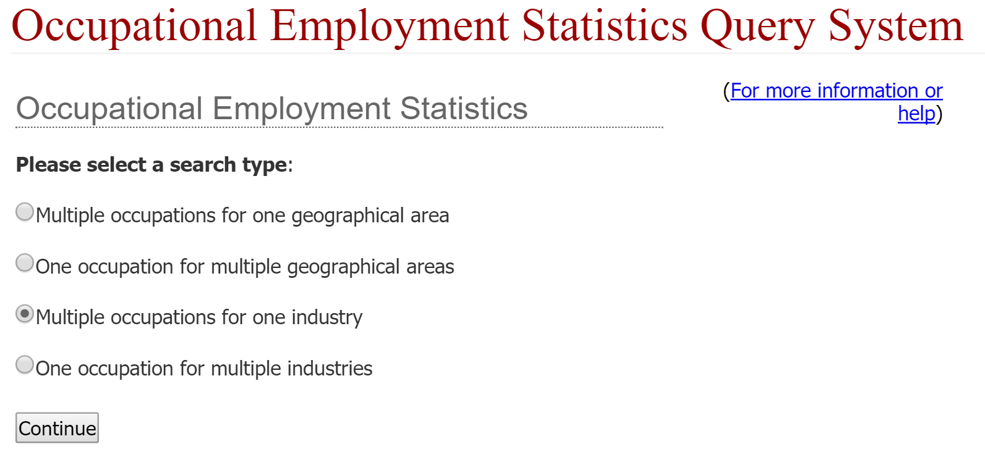
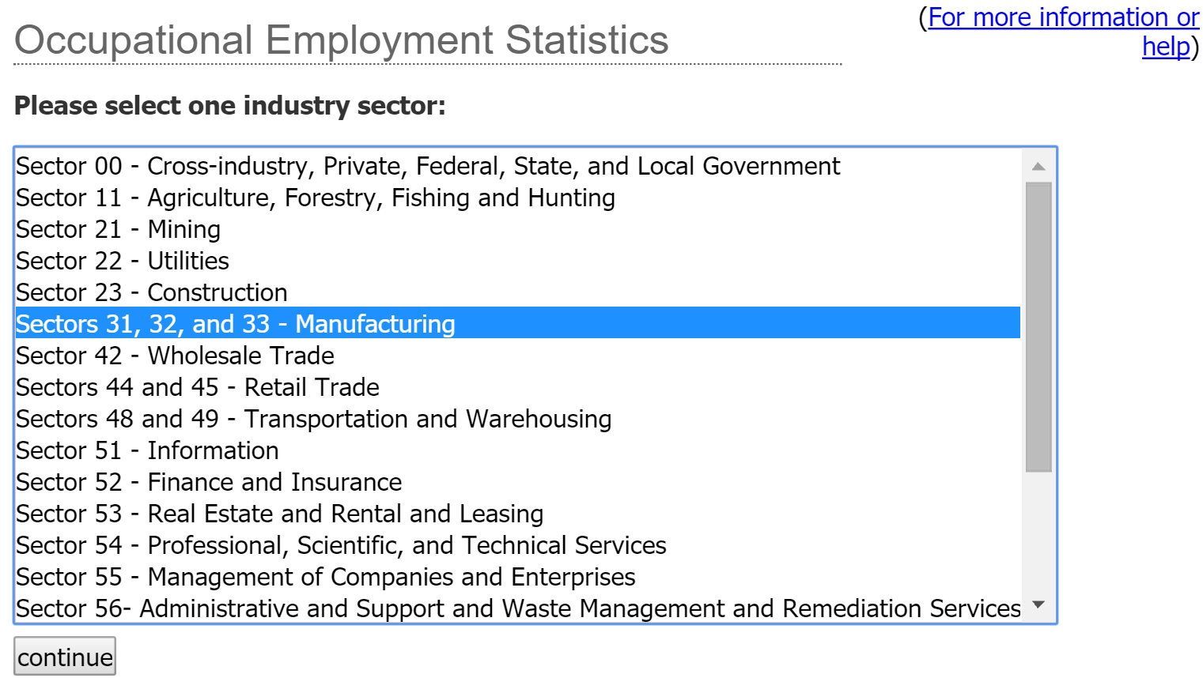
Download industry wage data from the U.S. Bureau of Labor Statistics
Step 1
3. Select ‘Multiple occupations for one industry’
4. Find the appropriate industry sector for the NAICS code you are looking up

Slide 4
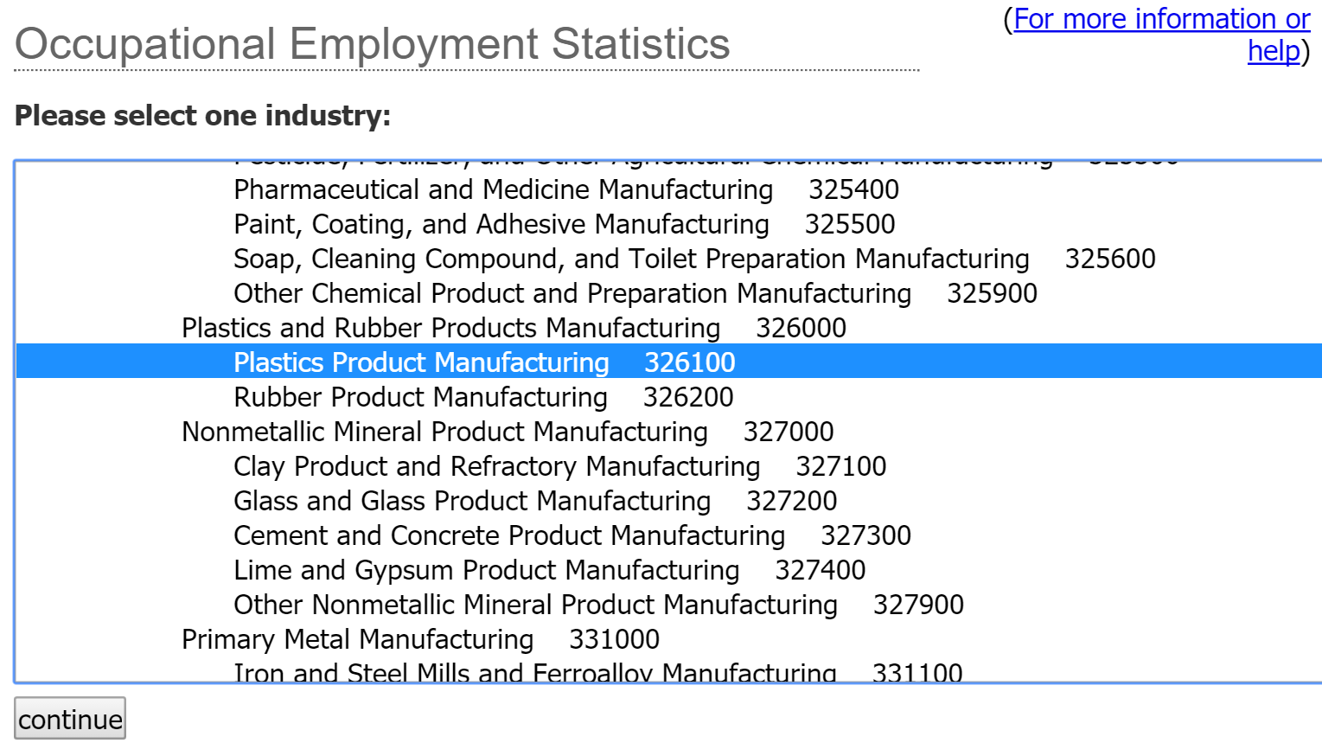
Download industry wage data from the U.S. Bureau of Labor Statistics
Step 1
5. Highlight the industry NAICS code of interest
6. Select ‘All occupations in this list’

Slide 5
Download industry wage data from the U.S. Bureau of Labor Statistics
Step 1
7. Highlight both ‘Employment’ and ‘Annual mean wage’
8. Select the most recent release date and ‘EXCEL’ as the output type
When you click ‘continue’ an excel file will download

Slide 6
Select which occupations are Direct Labor
Step 2
1. Open the downloaded excel file

Slide 7
Select which occupations are Direct Labor
Step 2
2. Label Column D ‘Direct Labor’
3. Label which occupations are Direct Labor
Label the direct labor occupations (y/n)

Slide 8
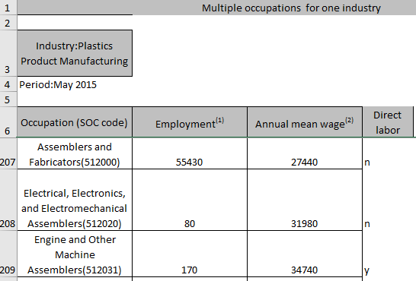
Select which occupations are Direct Labor
Step 2
4. Do not label any occupation that has a SOC code that ends in “O” as Direct Labor, as these are higher-level groupings that contains multiple occupations. If you label and include them you will end up double counting the numbers.
SOC codes

Slide 9
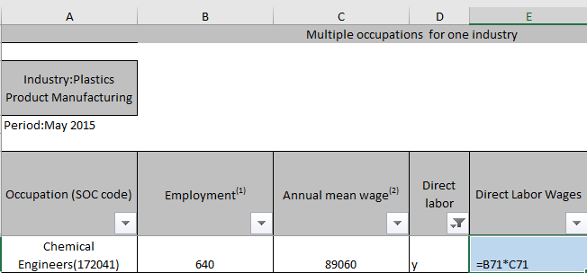
Calculate the Direct to Total Labor ratio for the industry
Step 3
1. Label Column E ‘Direct Labor Wages’
2. Multiply the values of column B and column C for all occupations that you labelled as ‘Direct Labor’, this gives you the total wages for that occupation

Slide 10
Calculate the Direct to Total Labor ratio for the industry
Step 3
3. Label Column F ‘Total labor wages’ and calculate by multiplying values of column B and column C for ‘All Occupations (000000)’ in row 7
4. Label Column G ‘Direct labor Wages’ where you calculate the sum of column E

Slide 11
Calculate the Direct to Total Labor ratio for the industry
Step 3
5. Label Column H ‘Direct Labor to Total Labor Ratio’ and calculate by dividing ‘Direct Labor Wages’ by ‘Total wages’ (Column G4 / Column F4).

Slide 12
Tip
Use the U.S. Direct-to-Total Labor ratio as a proxy ratio when building an Industry Cost Profile for a country where only information for Total Wages is available.

